Slide 1
Spider monkey
交換子SO / 交換序SS
T | 3 | 0 | 1 | 2
SO(1,2)
T | 3 | 1 | 0 | 2
T | 3 | 0 | 1 | 2
SO(1,2)
SO(0,3)
SO(3,1)
T | 0 | 2 | 3 | 1
交換序SS

Slide 2
Spider monkey
交換子SO / 交換序SS
T | 3 | 0 | 1 | 2
SO(1,2)
SO(0,3)
SO(3,1)
T | 0 | 2 | 3 | 1
T1
交換序SS
T2
SO(1,2)
SO(0,3)
SO(3,1)
T | 0 | 2 | 3 | 1
T | 3 | 0 | 1 | 2
交換序SS
T2
T1
T2-T1 = T1走到T2的過程

Slide 3

Spider monkey
交換子SO / 交換序SS
SO(1,2)
SO(0,3)
SO(3,1)
SO(0,3)
SO(2,1)
SS1
SS2
SO(1,2)
SO(0,3)
SO(3,1)
SO(0,3)
SO(2,1)
SS3

Slide 4
Spider monkey
BSS (Basic Swap Sequence)
SO(0,3)
SO(2,4)
SO(4,3)
T1
SS1
T2
5 | 1 | 2 | 3 | 4
3 | 1 | 4 | 2 | 5
SO(2,1)
SO(1,2)
SO(0,3)
SO(2,4)
SO(3,4)
SS2

Slide 5
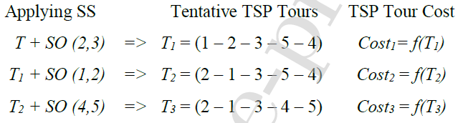
Spider monkey

Slide 6
Spider monkey
步驟:
區域領導階段 (Local Leader Phase)
全域領導階段 (Global Leader Phase)
全域學習階段 (Global Learning Phase)
區域學習階段 (Local Learning Phase)
區域決策階段 (Local Leader Decision Phase)
全域決策階段 (Global Leader Decision Phase)

Slide 7
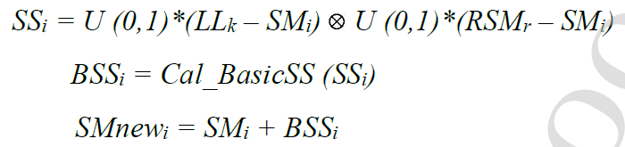
Spider monkey
1. 區域領導階段 (Local Leader Phase) :
if random > pr:

Slide 8
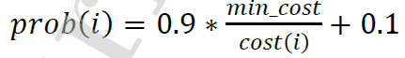
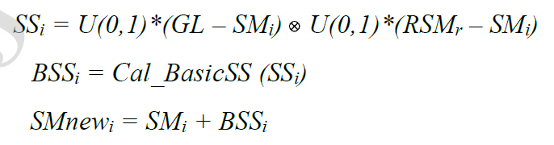
Spider monkey
2. 全域領導階段 (Global Leader Phase)
計算更新率
If random < prob(i)

Slide 9
Spider monkey
3.全域學習階段 (Global Learning Phase)
Global Limit Count 全域限制計數器 / Global Leader Limit 全域領導限制
If ( new global leader value < global leader value )
更新全域領導
Global Limit Count =0
Else
Global Limit Count = Global Limit Count +1

Slide 10
Spider monkey
4.區域學習階段 (Local Learning Phase)
Local Limit Count 區域限制計數器 / Local Leader Limit 區域領導限制
If ( new local leader value < local leader value )
更新區域領導
Local Limit Count =0
Else
Local Limit Count = +1

Slide 11
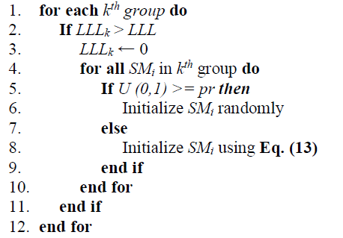
Spider monkey
5.區域決策階段 (Local Leader Decision Phase)

Slide 12
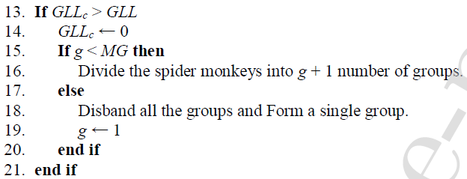
Spider monkey
6.全域決策階段 (Global Leader Decision Phase)

Slide 13
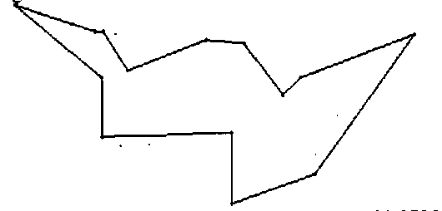
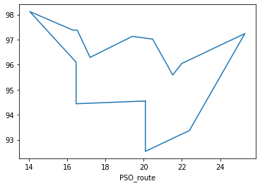

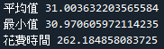
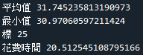
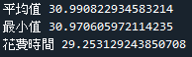
Spider monkey
距離=30.87
SMO
PSO
GA

Slide 14
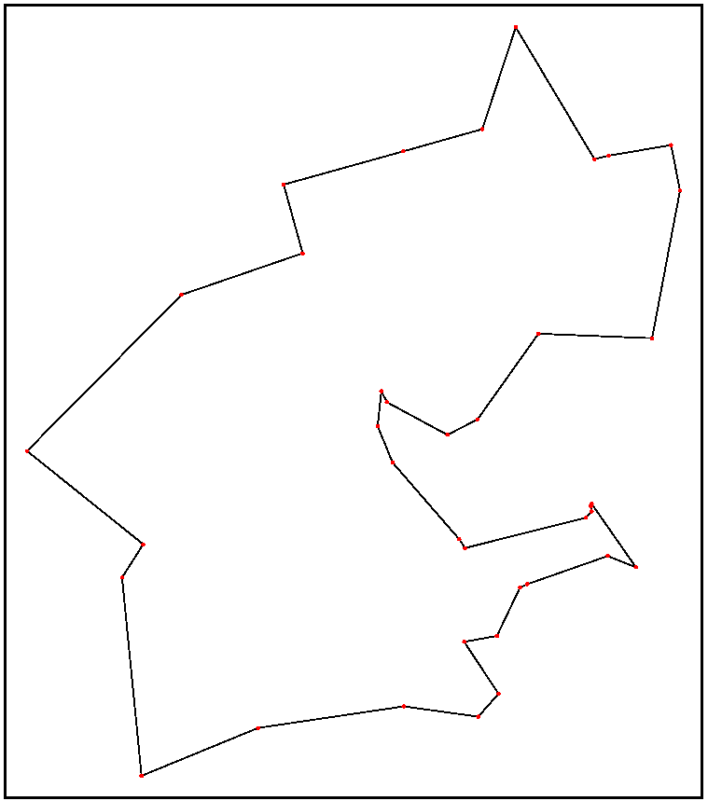
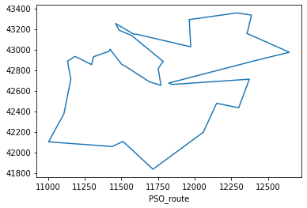
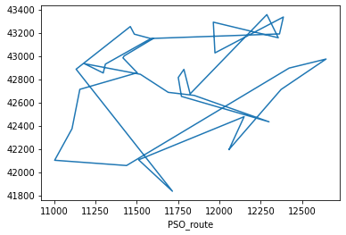
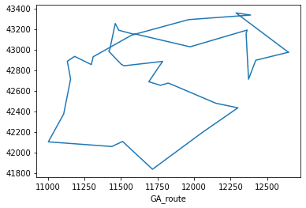
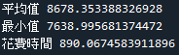
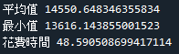
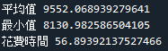
Spider monkey
距離=6656
SMO
PSO
GA

Slide 15
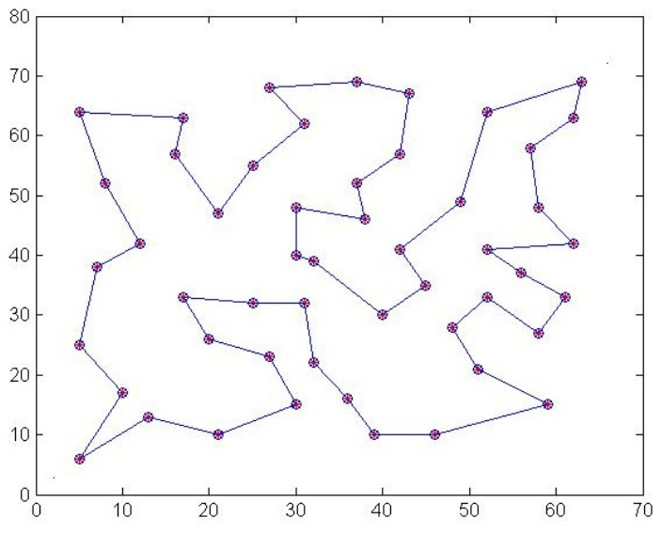
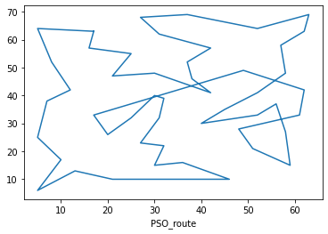
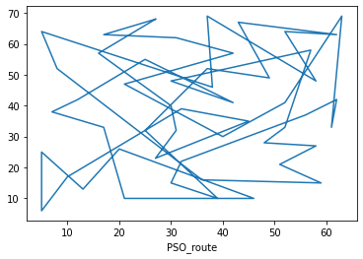
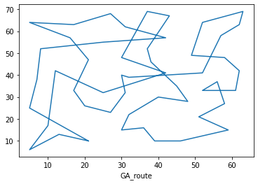
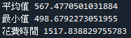
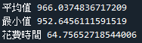
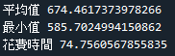
Spider monkey
距離=429.9833
SMO
PSO
GA

